Slide 1

Silent Speaker
A Lip-reading Model Using Deep Learning
Final Presentation

Slide 2

Group Members
01
Faria Karim Porna
ID : 1620424042
02
Nazmul Hauqe
ID : 1530862642
03
Md. Sazzad Hossain Bhuiyan
ID : 1521643042.
04
Hira
ID : 1522085642.

Slide 3

Introduction
Lip-reading is the task of decoding text from the movement of a speaker’s mouth.
Studies have shown that human lip-reading performance increases for longer words.
Motivated by this observation, we will build a model that maps a variable-length sequence of video frames to text by using sentence-level sequence prediction.
We will build our model based on Bangla language.

Slide 4
Why is lip-reading?
It will help deaf people as a hearing aid.
It will help others to recognize the speech of mute people.
It will also help to detect criminals in the detective branch.
It can be used for security purposes.
It can be used for video captioning.
This model will help to recognize speech in noisy areas.
It can be used in silent-movie processing.
It will help to detect fake video.

Slide 5

Literature Reviews
Lip-reading and Speech Recognition Models

Slide 6
Paper’s Name - LipNet: End-to-End Sentence-level Lip reading
Data Set | GRID corpus (1000 sentences by 34 talkers (18 male, 16 female)
Model | Spatiotemporal Convolutional Neural Network (ST-CNN) Bi-directional Gated Recurrent Unit Connectionist Temporal Classification (CTC)
Accuracy | 95.2%

Slide 7
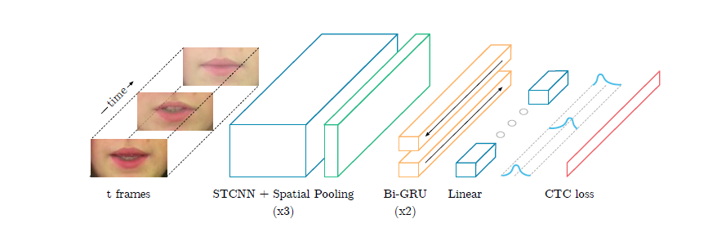
Paper’s Name - LipNet: End-to-End Sentence-level Lip reading

Slide 8
Paper’s Name - LipNet: End-to-End Sentence-level Lipreading
Spatiotemporal Convolutional Neural Network : ST-CNN is used for extracting feature for spatiotemporal data.
Bi-directional GRU : It is used as sequential model because bi directional GRU model predict the current word in a sentence based on both the previous and later data.
Connectionist Temporal Classification : It is a operation to tackle sequence problems where timing is variable. It assigns the character with the highest probability (or no character) to every input sequence.

Slide 9
Paper’s Name - Lip-reading via a DNN-HMM hybrid system using combination of the image-based and model-based features
Data Set | CUAVE
Visual feature | The simple raw gray level information of the lips Region of Interest (ROI) The geometric representation of lips shape and The Deep Bottle-neck Features (DBNFs)
Recognition System | The conventional GMM-HMM and The state-of-the-art DNN-HMM hybrid model

Slide 10
Why this features have been used?
Raw Gray Level ROI Features ROI convert the matrix of grayscale images to a 1000×1 vector.
Lips Shape Features
The Active Shape Model (ASM) approach is employed to locate landmarks on speaker’s lips, using STASM library. In order to make the feature vector, the coordinates of all the lips inner and outer landmarks must be concatenated. Furthermore, the height and width of the lips are evaluated and added to the feature vector.

Slide 11
Paper’s Name - Lip Reading in the Wild
They show that CNN architectures can be used to classify temporal sequences with excellent results.
On the 333-word test set, they achieved top-1 accuracy of 65.4%, which exceeds state-of-the-art on multiple datasets that have lexicon sizes that are orders of magnitude smaller, and a top-10 accuracy of 92.3%.
They also demonstrate a recognition performance that exceeds the state of the art on a standard public benchmark dataset, Oulu VS.
Next steps include extending to lip reading of proﬁle views, and combining the CNNs pre-trained using this approach with LSTMs trained with a language model in order to recognize sentences rather than individual words.
Of course, the visual only speech recognition method developed here can also be combined with audio only speech recognition to both their beneﬁts.

Slide 12
Papers Name - Thai Lip-Reading CAI for Hearing Impairment Student
They developed the CAI application that is used as a lip reading learning tool for hearing impaired student.
Structure of this CAI consist of learning lesson unit and game unit.
For The learning lesson unit, student will learn to understand mouth movement of each vocabulary that use in daily life. They can practice and compare their mouth shape with example mouth model.
For the game unit, student plays the multiple-choice game to select the correct answer of the question.
They conducted an experiment to test if the CAI can help and serve as a learning platform. The result is measured from effectiveness. The test for effectiveness showed positive results.
From the pre-test and post-test process, all student scored are more after learning the CAI. Experiment data showed that the number of correct answer increased. In addition, the feedback after CAI using, the students attend to learn and would like to play the game.

Slide 13
Paper’s name - LCANet: End-to-End Lipreading with Cascaded Attention-CTC
Data Set | GRID corpus
Models | LCANet Connectionist Temporal Classification (CTC) The attention-based sequence to sequence(seq2seq) model Markov models (HMMs)
Approach | The mouth regions are cropped from the input video frames from aligned faces. An encoder extracts spatiotemporal features from the input sequence. The cascaded attention-CTC decoder generates text from encoded hidden features.

Slide 14
Paper’s Name - END-TO-END VISUAL SPEECH RECOGNITION WITH LSTMS.
In this paper they have presented an end-to-end visual speech recognition system which jointly learns to extract features directly from the pixels and perform classiﬁcation using LSTM networks.
Results on subject independent experiments demonstrate that the proposed model achieves state-of-the-art performance on the OuluVS2 and CUAVE databases when compared with models which use a similar visual front end.

Slide 15
Paper’s Name - End-to-End Multi-View Lip-reading
In this work, they have presented an end-to-end multi-view lip reading system which jointly learns to extract features directly from the pixels and performs classification using BLSTM networks.
The proposed model achieves state-of-the-art performance on the OuluVS2 without using external data for training or even data augmentation.
The provided mouth ROIs are well cropped and this might not be the case when automatic tools for mouth ROI detection are used.
The model can be easily extended to multiple streams so they added an audio stream in order to evaluate its performance on audiovisual multi-view speech recognition.

Slide 16
Paper’s Name - Speaker identification by lipreading
In this paper, a novel approach, fix speaker identification has been described on ca spatial and temporal analysis of the mouth.
Facial features are extracted from image sequences which represent the shape and intensity of the lips. The features are of low dimension and invariant to scale, translation and rotation.
They considered the small training and test duration.
Results are encouraging and demonstrate that lip intonation is an important cue for person idmt5catim.
Further experiments are necessary to evaluate the performance of the method for a large number of subjects and to investigate the benefit of combining it with other approaches like speaker recognition and fact recognition.

Slide 17
Paper’s Name - A real-time lip localization and tacking for lip reading
In this paper, they described a new robust approach to improve lip localization and tracking.
The first part of their proposed algorithm is lip location based on OpenCV. From experimental results, their proposed method can successfully detect the lip region. Results from the lip location accuracy allowed more accurate lip region segmentation.
In the second part, a new method called a component of Lab color space is proposed to accurately extract lip shape and track lip region. Overall, their implemented approach has shown high reliability and is able to perform robustly under various conditions.

Slide 18
Paper’s Name - Lip localization technique towards an automatic lip reading approach for Myanmar consonants recognition
This paper proposed the technique to localize lip region for the Myanmar consonants recognition.
The experimental system demonstrates that this technique performs lip motion sequences in video.
In their experiment, they have localized all of the test lip movement successfully and the results were perceived to be acceptable for lip reading.

Slide 19
Paper’s Name - Geometry Based Lip Reading System Using Multi Dimension Dynamic Time warping
Data Set | CUAVE
Model | Separate classification Dynamic Time warping (DTW) Multi- Dimensional DTW
Accuracy | 72%

Slide 20
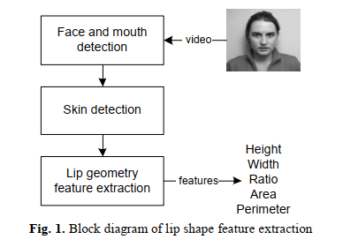
Lip geometry feature extraction using skin color filter, border following and convex hull
Main purpose of the thesis paper

Slide 21
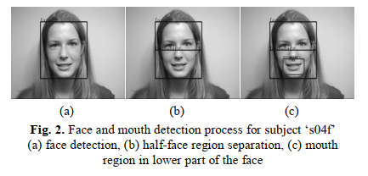
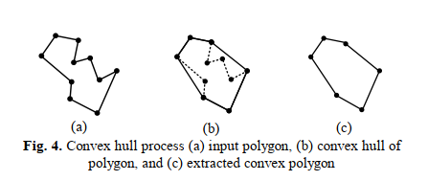
Face and Mouth Detection
A wide range of techniques are available for extracting the face and mouth region, such as template matching and motion detection. Here first detect a mouth and split it two part because lip always in lower part of the mouth and also a reason to avoid the risk of false detection that can arise from the inadvertent classification of an eye as a mouth .
Lip Geometry feature extraction
The segmented image containing the lip region is then converted to a binary format and contour extraction using border following is applied .When they wanted to represent the binary part into graph then that will be a poor representation because there will a polyline without many intercepting portion to join all intercept and make a large shape need to apply convex hull process.

Slide 22
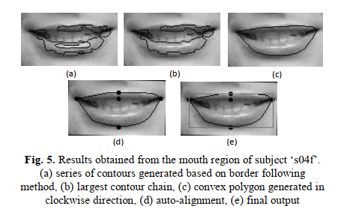
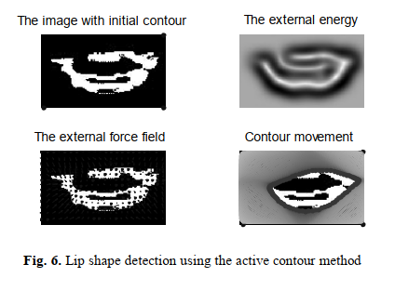
With applying border following and convex hull they have found a proper shape of a lip.
Comparison with state of the art
In Fig. 6 using the binary lip image as input. It shows that the active contour technique was unable to convergence to a suitable lip shape despite using a wide range of parameters. The failure to converge is due to the external energy generated not being clearly confined within the region of the mouth. A further drawback of the active contour method is the time it takes to convergence compared to the convex hull approach and the fact that the termination of the algorithm is highly dependent on the criteria set during evaluation.

Slide 23
Paper’s Name - Lipreading using convolutional neural network
In this paper, they have trained a CNN with images of a speaker’s mouth area in combination with phoneme labels, the CNN acquires multiple convolutional filters, used to extract visual features essential for recognizing phonemes.
Their proposed system is evaluated on an audio-visual speech dataset which is comprised of 300 Japanese words with six different speakers.
The average phoneme recognition performance is 58%.
The mean recognition rate for all vowels is 60-100%, whereas the mean recognition rate for all other phonemes is 20-80%.

Slide 24
Paper’s Name - Lipreading with long short-term memory
In this paper, feedforward and recurrent neural network layers (LSTM) are stacked to form a single structure which is trained by back-propagating error gradients through all the layers. The performance of such a stacked network was experimentally evaluated and compared to a SVM classifier using conventional computer vision features (Eigenlips and Histograms of Oriented Gradients).
They have used GRID corpus dataset.
The accuracy on the letters is 69.8, the accuracy on the non-letter words is 93.4% .
The total accuracy is 82.0%.

Slide 25
Paper’s Name - Deep inside convolutional networks: visualizing image classification models and saliency maps
Their visualisation experiments were carried out using a single deep ConvNet. Their weight layer configuration is: conv64-conv256-conv256-conv256-conv256-full4096-full4096-full1000, where convN denotes a convolutional layer with N filters, fullM – a fully-connected layer with M outputs.
They trained on the ILSVRC-2013 dataset, which includes 1.2M training images, labelled into 1000 classes.
On ILSVRC-2013 validation set, the network achieves the top-1/top-5 classification error of 39:7%=17:7%, which is slightly better than 40:7%/18:2%, reported in for a single ConvNet.

Slide 26
Paper’s Name - Audio-visual speech recognition using bimodal-trained bottleneck features for a person with severe hearing loss
They proposed a novel visual feature extraction approach that connects the lip image to audio features efficiently, and the use of CBN’s increases robustness with respect to speech fluctuations caused by hearing loss.
They have used utterances of one male person with hearing loss, where the text is the same as the ATR Japanese speech database A-set where 2,620 words are used as training data, and 216 words as test data.

Slide 27
Paper’s Name - Audio-visual speech recognition using bimodal-trained bottleneck features for a person with severe hearing loss
Their proposed audio-visual feature outperforms the AV BNF I in the clean environment and SNR of 20dB, where the integrated features between the audio and the proposed visual bottleneck features improved 3.3% and 3.8% compared with the AV BNFs I, respectively.
However, at the SNRs of 10dB and 5dB, the integrated feature using their proposed feature could not improve the accuracy in comparison with that of the AV BNF I.

Slide 28
Paper’s Name - Lip reading using CNN and LSTM
They employed a VGGNet pre-trained on human faces of celebrities from IMDB and Google Images. The VGGNet is trained on images concatenated from multiple frames in each sequence, as well as used in conjunction with LSTMs for extracting temporal information.
They have used the MIRACL-VC1 dataset in their project.
They have achieved best validation accuracy of 76%, and the test accuracy of their best model is 44:5%.

Slide 29
Paper’s Name - Comparison of human and machine-based lip-reading
In this paper, the authors have contrasted the performance of a machine-based lip-reading system with human lip-reading ability.
To train machine-based lip-reading systems, word-level HMMs were trained from both shape-only and full shape and appearance features using a leave-one-out cross-validation framework. The topology of the HMMs was optimised and the best performing topology used in the evaluation. This was a topology of 16 states each with 3 Gaussian mixture components.

Slide 30
Paper’s Name - Comparison of human and machine-based lip-reading
To measure the baseline performance of human lip-readers, 17 computing undergraduate students from a UK University volunteered to take part in the experiment.
At both the phoneme and viseme levels, the automated system performed significantly better than the human participants and achieved recognition rates of 80.27% and 91.6% (full shape and appearance) compared to 31.6% and 35.4% respectively.

Slide 31
Paper’s Name - Improved speaker independent lip reading using speaker adaptive training and deep neural networks
In this paper, it is shown that the application of SAT appears to have considerable promise in speaker-independent lipreading.
For data they have used an audiovisual corpus of twelve from the Resource Management Corpus.
The HMM/GMM systems that they built are: (i) monophone and monoviseme systems with ∆ and ∆ ∆ features (Mono), (ii) ((Tri:LDA)) (iii) ((Tri:LDA+MLLT)), (iv) (Tri:LDA+MLLT+SAT).
They found that word recognition accuracy is always higher when phonemes are used as the modelling units rather than visemes.

Slide 32
Paper’s Name - Listening with your eyes: towards a practical visual speech recognition system using deep boltzmann machines
In the experiment, the visual feature learned by the Deep Boltzmann Machine (DBM) is concatenated with Discrete Cosine Transform (DCT) feature vector, followed by a Linear Discriminant Analysis (LDA) to decorrelate the feature and reduce the feature dimension. Then, the Gaussian Mixture Model- Hidden Markov Model (GMM-HMM) is used as a classifier for visual speech recognition.
The data corpus used in this paper was collected through an Australia wide research project called AusTalk.
Their proposed method showed the accuracy of 69.1%.

Slide 33
Paper’s Name - Towards End-to-End Speech Recognition with Recurrent Neural Networks.
This paper has demonstrated that character-level speech transcription can be performed by a recurrent neural network with minimal pre-processing and no explicit phonetic representation.
The experiments were carried out on the Wall Street Journal corpus (available as LDC corpus LDC93S6B and LDC94S13B).
The system achieves a word error rate of 27.3% on the Wall Street Journal corpus with no prior linguistic information, 21.9% with only a lexicon of allowed words, and 8.2% with a trigram language model.

Slide 34
Literature Reviews
Bangla Speech Recognition Models

Slide 35
Paper’s Name - Bangla speech-to-text conversion using SAPI
The aim of this study is to investigate Speech-to-Text (STT) conversion using SAPI for Bangla language.
SAPI is a middleware that provides an API and a device driver interface (DDI) for speech engines to implement. Microsoft Windows 7 operating system supplies default recognition and synthesis speech engines.
This study used English language as a middleware to manage SAPI for Bangla STT conversion.
The recognition rate was 78% when the system is tested for an article of a newspaper.

Slide 36
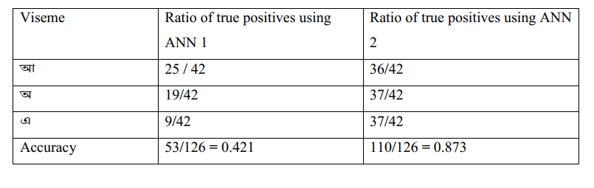
Paper’s Name - Recognition System using Lip Curvature and Neural Networks to Detect Bangla Vowels
Data Set | Own
Testing Result

Slide 37
Paper’s Name - Recognition System using Lip Curvature and Neural Networks to Detect Bangla Vowels
Summary
In their thesis paper they try to track 3 vowel of Bangla language ( আ, অ, এ ).
For doing this they follow some steps:
Image acquisition
Face detection
Lip detection
Lip segmentation
Viseme detection

Slide 38
Face and Mouth Detection
A wide range of techniques are available for extracting the face and mouth region, such as template matching and motion detection. Here they first detect a mouth and split it into two parts because lip is always in lower part of the mouth and also a reason to avoid the risk of false detection that can arise from the inadvertent classification of an eye as a mouth.
Lip segmentation
Lip segmentation is the method used to detect or trace the contour or edge of the lips so that we can get the shape of the lip at various instances or frames. For tracing the full shape of the lip they use convex hull algorithm.

Slide 39
Viseme Recognition
After extracting the features, they started viseme recognition. Most popular classifiers for speech recognition are Artificial Neural Networks (ANNs), PCA Classifier,KNN classifier and Support Vector Machines (SVM) and Hidden Markov Models (HMM). In this thesis paper ANN is used for viseme recognition.

Slide 40
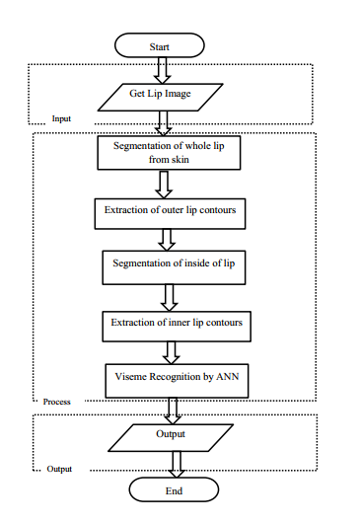
Flow chart of the thesis paper

Slide 41
Paper’s Name - A bengali hmm based speech synthesis system
The aim of this study is to present the capability of an HMM-based TTS system to produce Bengali speech.
In this synthesis method, trajectories of speech parameters are generated from the trained HMM. A final speech waveform is synthesized from those speech parameters. In their experiments they represent spectral properties by Mel Cepstrum Coefficients.
The speech database employed here for training purpose is originally developed by C-DAC. The output of the Bengali-HTS is also compare with previously developed Epoch Synchronous Non Overlap Add (ESNOLA) based concatenated speech synthesis technique.
The total average score for the original sentences is 4.66 and the ESNOLA based synthesis sentence is 2.34HTS is 3.6.

Slide 42
Paper’s Name - Real Time Bengali Speech to Text Conversion using CMU Sphinx
The aim of this study is to present a model for voice to text conversion method for Bengali language using various techniques to refine the data and adapt it for the complexities of implementing Bengali characters.
CMU Sphinx 4 is open source frame work which was used to generate Bengali UNICODE font.
A digital audio workstation called Audacity was used to manipulate the recorded data.
The proposed model showed around 75% accuracy for the tested dataset. The best work done in this arena was using Microsoft SAPI which obtained a 78% accuracy.

Slide 43
Challenges
The challenge we are currently facing is to create our own dataset.
Because to build the proper dataset we have to cut the video clips into word by word very accurately.
It requires perfection and professionalism.
It is also difficult to align the words according to the video clips.

Slide 44
What Difference We Will Make
As we are working on Bangla language based system so we will collect Bangla dataset and will pre process according to the model.
We will try to employ large variation of words into the dataset. We will try to generate dataset using different angles.
The previous works done by others have mostly used front faced dataset. Here we will make change. We will also use the dataset where speaker can move face slightly while speaking but the model still can track the lip position accurately.
Some of the related works are speaker-dependent. Here we will try to build model based on speaker-independency.
Unlike others, we will try to reach our model to the application level also.

Slide 45
Work Done So Far
We have read several related papers to get more idea about the whole project.
We have collected required dataset which have been used in the existing models.
We have reproduced the existing related code.
We have trained the dataset based on several optimizers like RMSprop, Adam etc.

Slide 46
Work Done So Far
We are collecting Bangla language based video dataset from news videos.
Firstly, we will collect news videos of a specific news reporter. Here we are going to use the videos clips of “Mithila Islam” who is a renowned news presenter in “Bangla Vision News”.
Then we will try to generate Bangla caption of those videos.
After that we will cut the video word by word using video editing tool.
Finally we will convert those short video clips into multiple images.

Slide 47
Lets go to the coding part….

Slide 48
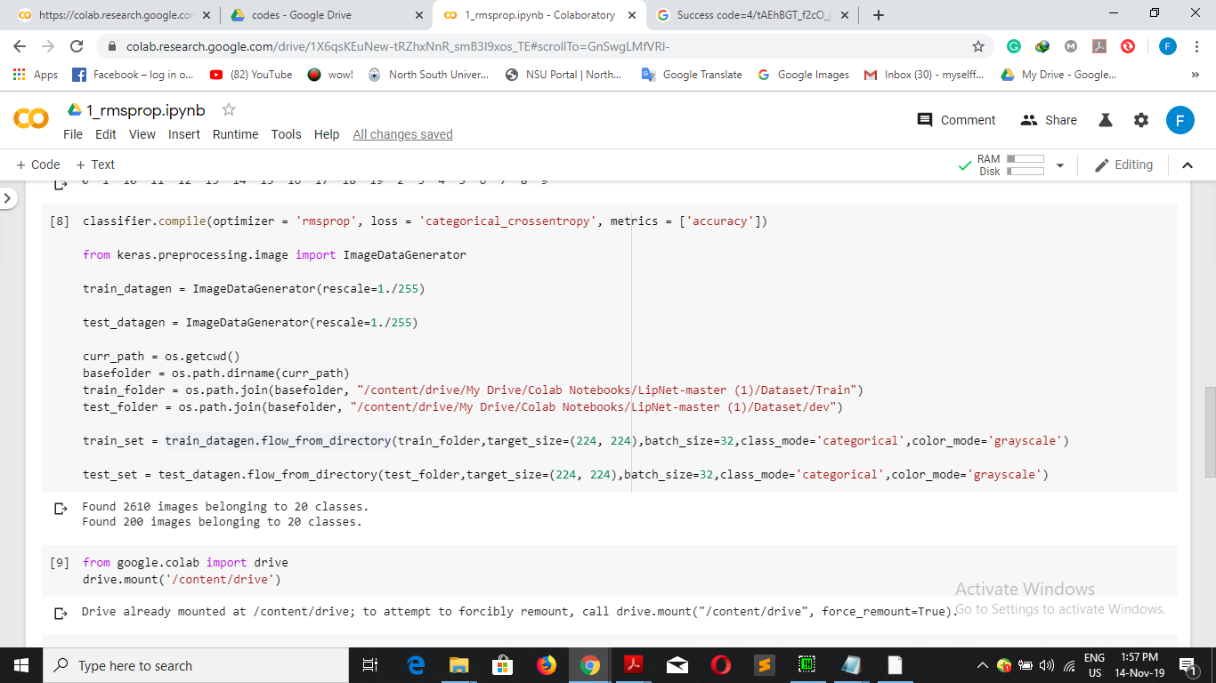
Coding Part

Slide 49
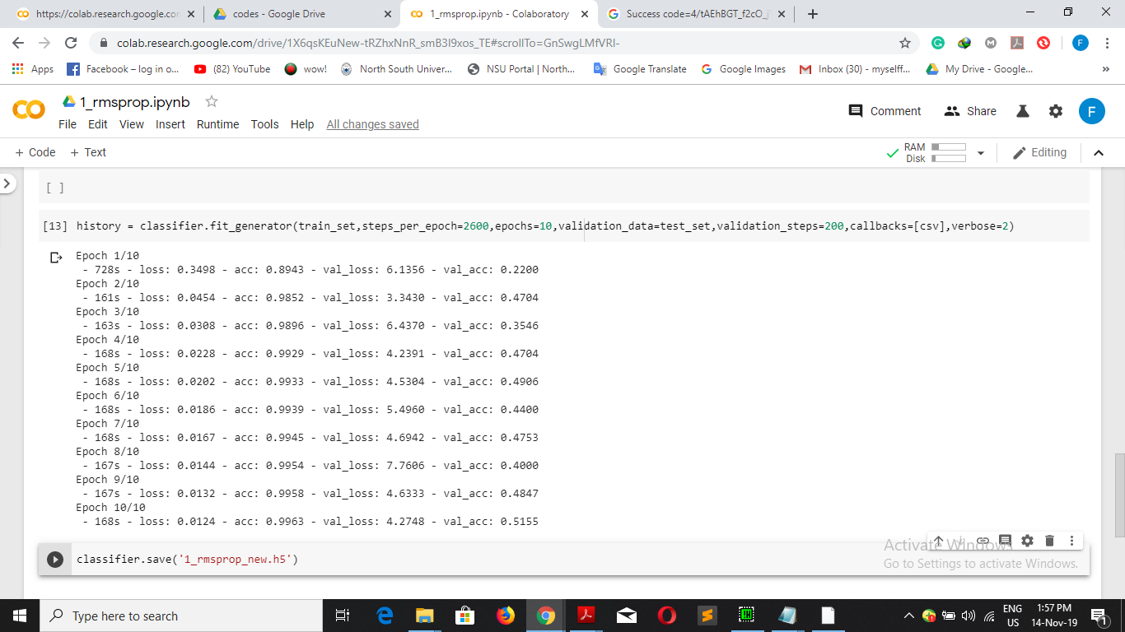
Coding Part

Slide 50
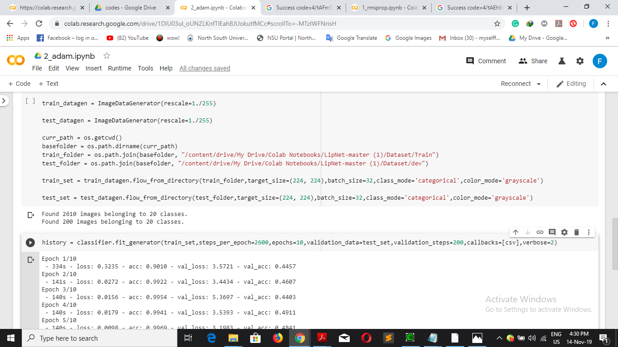
Coding Part

Slide 51
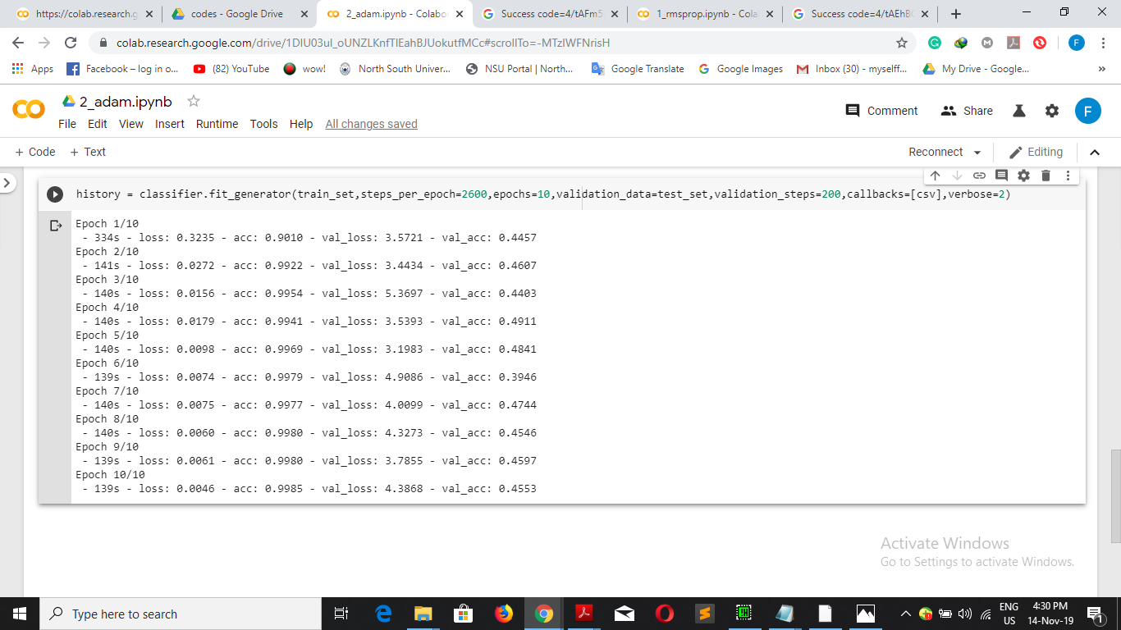
Coding Part

Slide 52
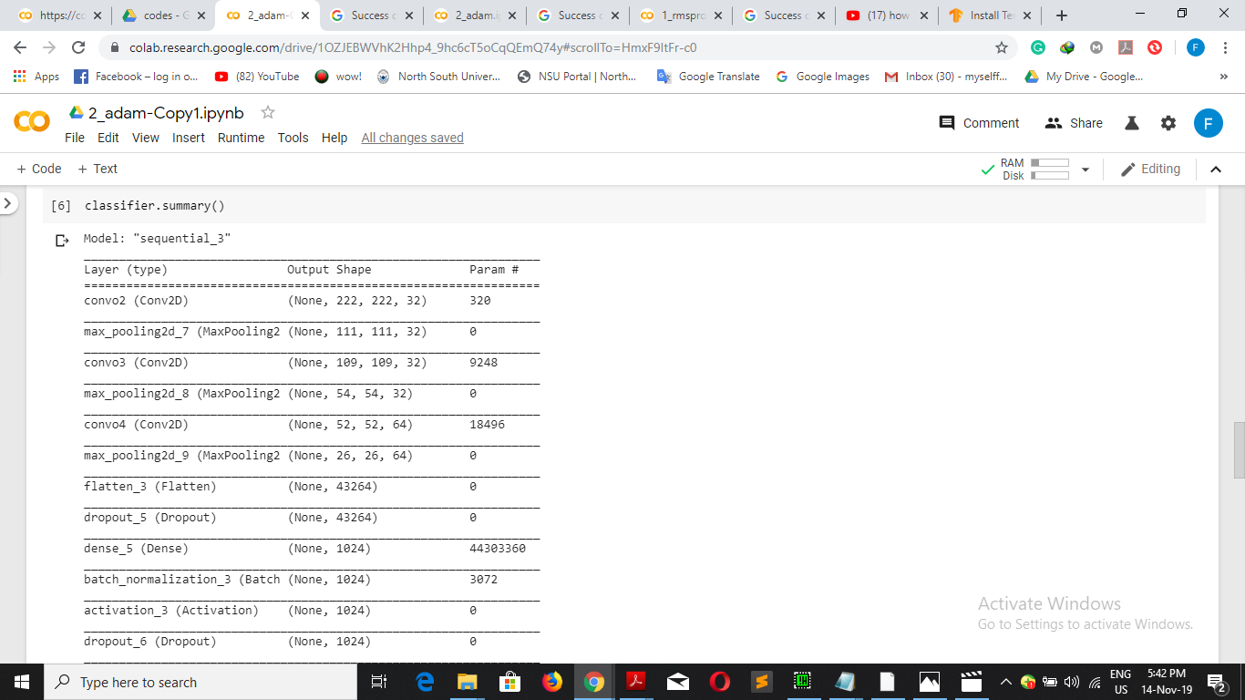
Coding Part

Slide 53
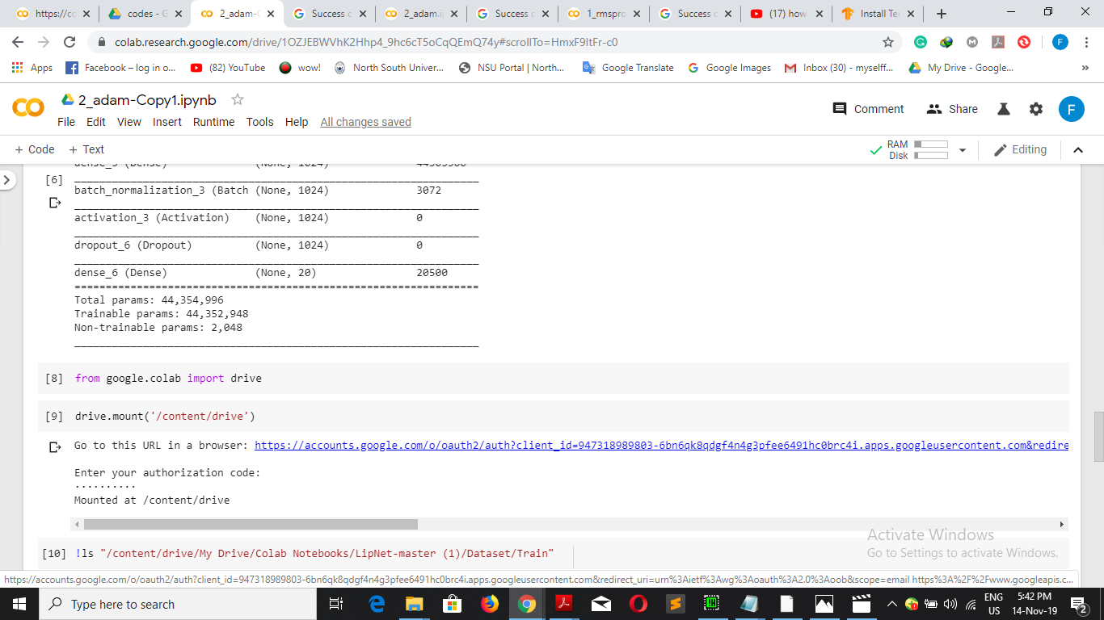
Coding Part

Slide 54
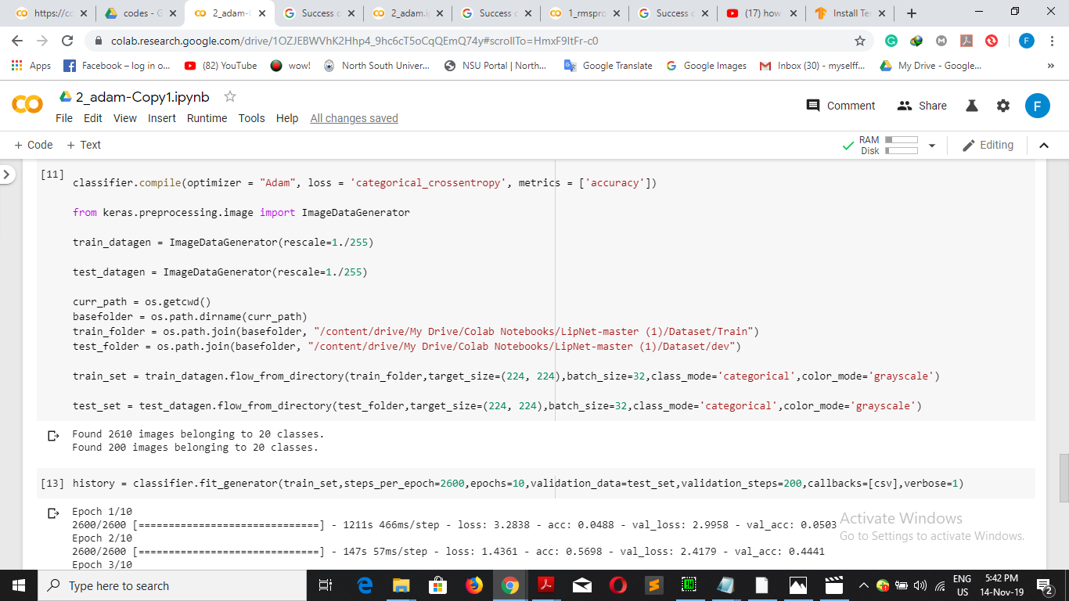
Coding Part

Slide 55
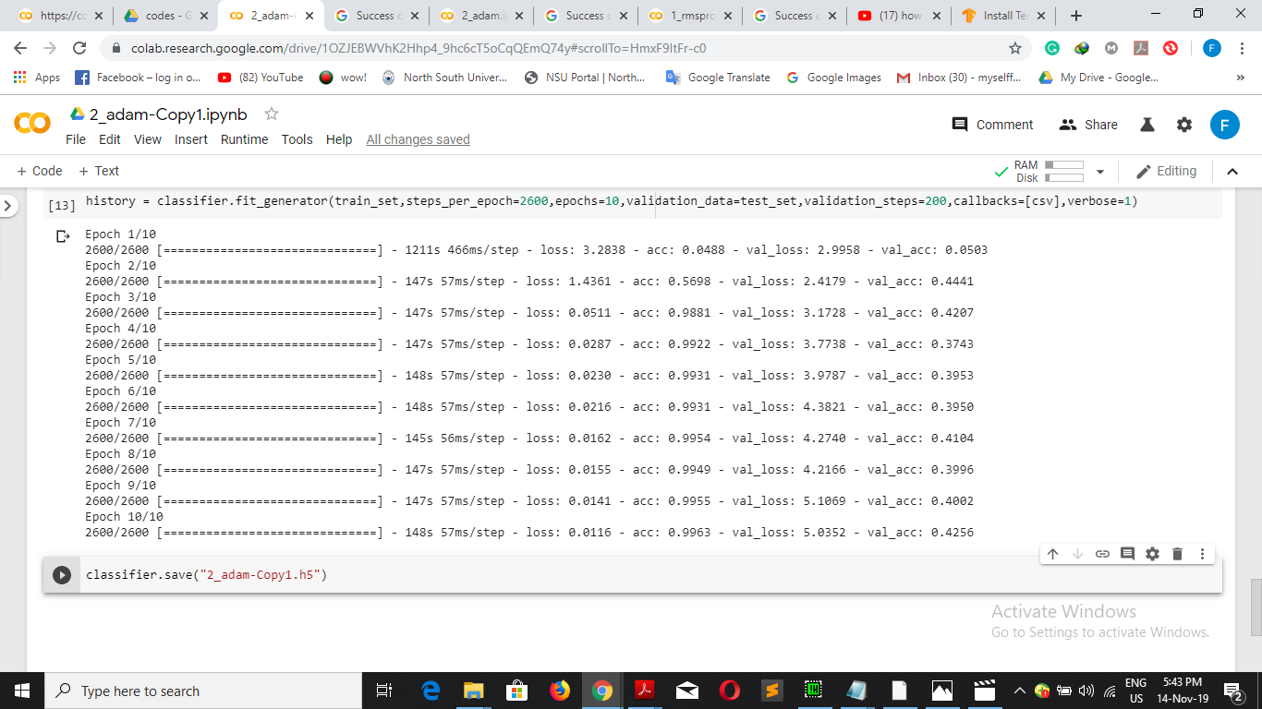
Coding Part

Slide 56
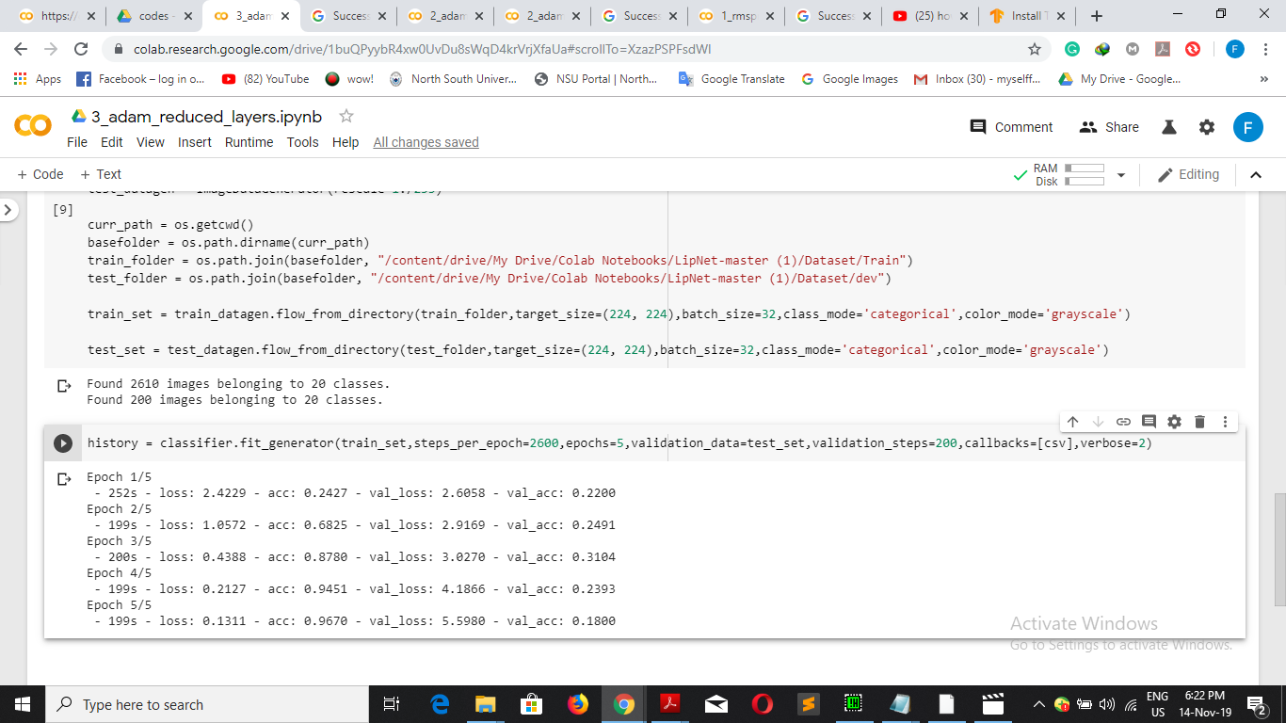
Coding Part

Slide 57
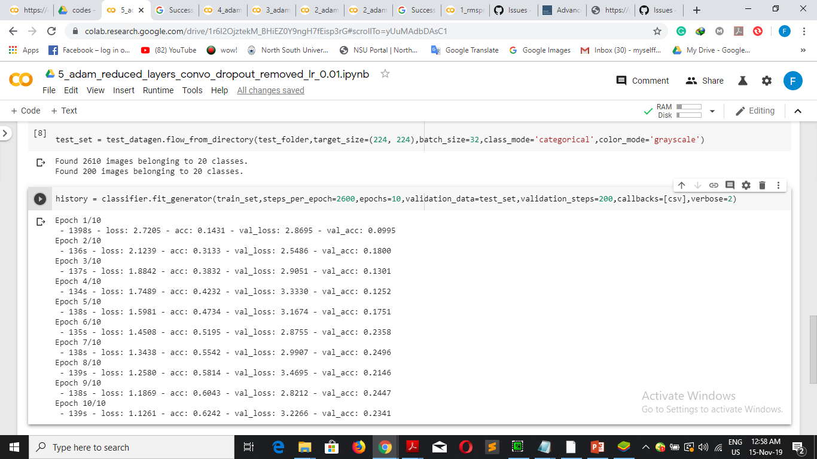
Coding Part

Slide 58
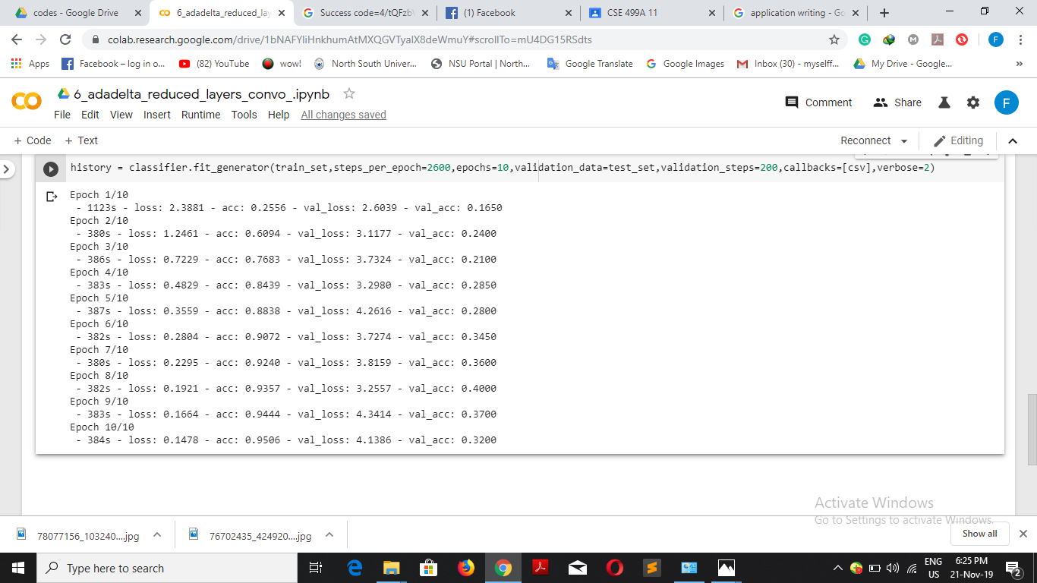
Coding Part

Slide 59
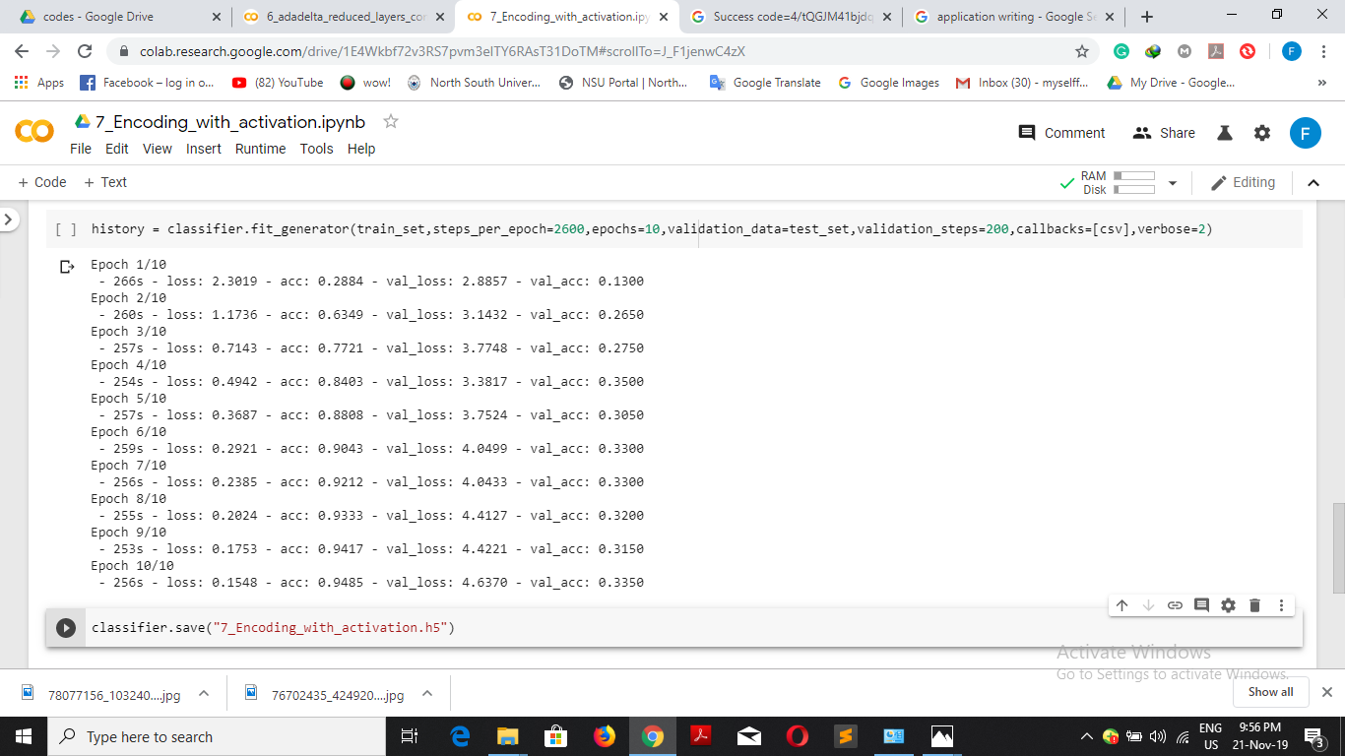
Coding Part

Slide 60
Goal
We will collect Bangla language based video dataset.
We will build our proposed model.
We will train and test the dataset in our proposed model.
We will use our build model in application level.

Slide 61

Thank You

